Slide 1
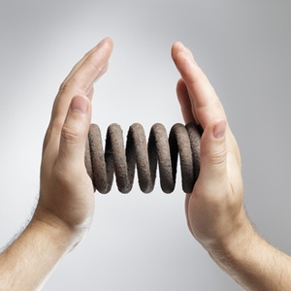
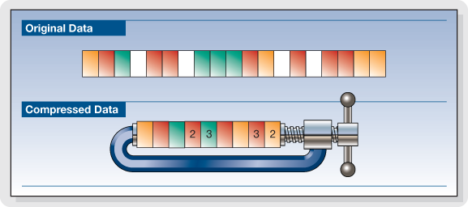
Compression
Shyamalendu Kandar
Assistant Prof. IT

Slide 2

Introduction
reduction in size of data in order to save space or transmission time.
Without Compression:
800*600 , 32 bit image will take ((800 X 600)X32)/(8X1024X1024) = 1.83 MB
2000 character text file will take 1.95 KB
1 minute audio stereo file will take 10 MB
1 minute video clip will take 2GB space.
resulting requirement of huge disk space, large transmission time,
Compression reduces the file size using mathematical algorithm.

Slide 3
Advantages & Disadvantages
Advantages:
Data storage and transmission cost money. ------ increases with the amount of data available.
This cost can be reduced by processing the data so that it takes less memory and less transmission time.
Disadvantage:
Compressed data must be decompressed .--------- extra processing is required.
involve trade-offs between various factors, including the degree of compression, the amount of distortion introduced (lossy compression ).
How Compression is possible?
information usually contains redundancies---- information that is often repeated.
Examples include reoccurring letters, numbers or pixels
compression programs remove this redundancy.

Slide 4

Different Types of redundancies
Statistical and Perceptual Redundancies:
some kind of statistical relationship existing within the media data.
exp: sequence of repeated pixel values, sequence of repeated characters
perceptual redundancies originates due to the characteristics of human sensory system.
Less sensitive information can be removed ----perception will not be affected drastically.
Used in image, video or audio compression

Slide 5
Different Types of redundancies
Spatial and Temporal Redundancies:
Mainly used in image or video compression.
Spatial: Some part of the image or a single frame of a video may have statistical or perceptual redundancies -----removing these leads to compression.
Known as intra frame compression for video compression
Temporal: part of a signal is similar to other parts occurring at different points in time frame.
consecutive frames of a video have very slide differences.
Known as inter-frame compression.

Slide 6
Lossless vs Lossy
digital data digitized from analog data referred to as raw data or uncompressed media data.
required CODEC to compress the file as well as for decompression.
Types of Compression:
lossless: original data is not changed permanently only altered
lossy: original data is changed permanently. after retrieval the quality is lost.
CODEC:
abbreviation of Compression/Decompression or coder/decoder
Compression Algorithm
Compressed Data
Storage Device
Decompression Algorithm
Compressed Data
Codec

Slide 7
Performance Measurement
Compression Ratio:
ratio of (uncompressed size/size of compressed data)
Compression factor: Inverse of compression factor.
Space saving: (1 - compression factor.) X 100

Slide 8
Lossless Compression Technique
Run length Encoding (RLE):
very simple form of data compression.
Applied in sequences in which the same data value occurs in many consecutive data elements.
let sequence of 6 characters ‘A’→ 6A.
AAAAAACCCCCBBDDDEEEEE can be represented as
6A5C2B3D5E.
Compression ratio: 21/10=2.1.
May be a problem for string with less consecutive data elements.
ABCDEF can be represented as
1A1B1C1D1E1F no benefit..

Slide 9
DPCM
Differential Pulse code modulation.
Proposed by C.C. Cutler in 1950.
Analog to digital by sampling, quantization and coding-----Pulse code modulation(PCM)
codes the difference between actual value of the sample and a prediction of that value.
a signal x(t) sampled to obtain the samples x(kT_{s}), T_{s} is the sampling period and k is an integer representing the sample number.
Let denote it as x(k).
difference between the present sample of a signal and the previous sample is d(k)= x(k)-x(k-1).

Slide 10
DPCM
Largest 12 , requires 4 bit, For sign 1 bit.
Total 30 bit
Largest 6 , requires 3 bit, For sign 1 bit.
Total 24 bit.
6,8,12,6, 4, 8
6,2,4,-6, -2, 4
PCM
DPCM
Further study Adaptive DPCM

Slide 11
Lempel-Ziv Coding
Proposed by Abraham Lempel, Jacob Ziv in 1978
Improved version proposed by Terry Welch in 1984.
Known as LZW algo.
Dictionary based coder.
Encoding:
I. Start constructing the dictionary by all strings of length one.
II. Find the longest string W in the dictionary that matches the current input.
III. Emit the dictionary index for W to output and remove W from the input.
IV. Add W followed by the next symbol in the input to the dictionary.
V. Go to Step 2.

Slide 12
Lempel-Ziv Coding-Example
Input String: BAABABBBAABBBBAA
Input String
Parsed String
Table
BAABABBBAABBBBAA
B
1
B
AABABBBAABBBBAA
A
1
2
B
A
ABABBBAABBBBAA
AB
1
2
3
B
A
AB
ABBBAABBBBAA
ABB
1
2
3
4
B
A
AB
ABB
1
2
3
4
5
BAABBBBAA
BA
B
A
AB
ABB
BA
ABBBBAA
ABBB
1
2
3
4
5
6
B
A
AB
ABB
BA
ABBB
BAA
BAA
1
2
3
4
5
6
7
B
A
AB
ABB
BA
ABBB
BAA
Compressed String B,A,2B,3B,1A,4B, 5A

Slide 13
Lempel-Ziv Coding-Example
Decompression:
Input String: B,A,2B,3B,1A,4B, 5A
Input String
Parsed String
Table
B
1
B,A,2B,3B,1A,4B, 5A
B
A,2B,3B,1A,4B, 5A
A
1
2
B
A
2B
1
2
3
2B,3B,1A,4B, 5A
B
A
AB
3B,1A,4B, 5A
3B
1
2
3
4
B
A
AB
ABB
1A
1
2
3
4
5
1A,4B, 5A
B
A
AB
ABB
BA
4B, 5A
4B
1
2
3
4
5
6
B
A
AB
ABB
BA
ABBB
5A
5A
1
2
3
4
5
6
7
B
A
AB
ABB
BA
ABBB
BAA
The string: BAABABBBAABBBBAA

Slide 14
Exercise
Decode:
ab0b1b0a2b4a2a6a5a5b7b3a
Encode
01100110010110000100110

Slide 15
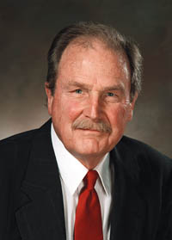
Huffman Coding
developed by David A. Huffman in 1952.
Statistical coding.
frequently used characters will be stored with fewer bits and not-so-frequently occurring characters will be stored with more bits
algorithm's output can be viewed as a variable-length code table for encoding a source symbol.
table based on the estimated probability or frequency of occurrence (weight) for each possible value of the source symbol.
The table may be derived from the input itself or from data which is representative of the input.

Slide 16
Huffman Coding
Algorithm:
1. Scanning and Counting: text to be compressed and count the occurrence of all characters.
2. Sort or prioritize: based on number of occurrences in text.
3. Tree Construction: Huffman code tree based on prioritized list.
4. Code word Construction: Perform a traversal of tree to determine all code words.
5. Encoded compressed File: Scan text again and create new file using the Huffman codes.

Slide 17
Huffman Coding-Algorithm
Step I:
Such that no character is left in the file
for i=0 to eof
scan a character c
set count(c)=0;
for j=i to eof
scan character c/.
if c= c/
count(c)=count(c)++
end if
j++
end
i=i+1;
end
Step II:
Sort the array count in increasing order

Slide 18
Huffman Coding-Algorithm
Step III:
Pick the first two elements x and y of the sorted array and construct a subtree with two characters as leaves.
Set the label of the root as
Remove x and y from the sorted array and place the new subtree in proper posing of the sorted array. [ If there exist any other elements with frequency , place it just after it].
Continue this process till the array become an one element array.
Output: A Tree called Huffman Tree
Step IV:
Parse the tree from root to leaf.
Assign ‘0’ for left subtree and ‘1’ for right subtree.

Slide 19
Huffman Coding-Example
BESU is the first IIEST in India.
Step I: Scanning & Counting: Step II: Sorting of prioritize
Letter Count
B 1
U 1
h 1
e 1
f 1
r 1
T 1
d 1
a 1
. 1
E 2
S 2
s 2
t 2
n 2
I 3
i 4
space 6
Letter Count
B 1
E 2
S 2
U 1
space 6
i 4
s 2
t 2
h 1
e 1
f 1
r 1
I 3
T 1
n 2
d 1
a 1
. 1

Slide 20
Huffman Coding-Example
Step III: Tree Construction
Step III: Code word Construction
A. From Frequency 1:
1 | 1 | 1 | 1 | 1 | 1 | 1 | 1 | 1 | 1 | 2 | 2 | 2 | 2 | 2 | 3 | 4 | 6
B
U
h
e
f
r
T
d
a
.
E
S
s
t
n
I
i
sp
2
2
2
2
2
B
U
h
e
f
r
T
d
a
.

Slide 21
Huffman Coding-Example
Modified Frequency:
2 | 2 | 2 | 2 | 2 | 2 | 2 | 2 | 2 | 2 | 3 | 4 | 6
E
S
s
t
n
2
2
2
2
2
I
i
sp
B
U
h
e
f
r
T
d
a
.
B. From Frequency 2 and 3:
4
4
4
4
4
n
2
2
2
2
2
E
S
s
t
B
U
h
e
f
r
T
d
a
.

Slide 22
Huffman Coding-Example
Modified Frequency:
3 | 4 | 4 | 4 | 4 | 4 | 4 | 6
I
i
4
4
4
4
4
sp
n
2
2
2
E
S
s
t
2
2
B
U
h
e
f
r
T
d
a
.

Slide 23
Huffman Coding-Example
8
7
8
4
4
I
i
4
4
E
S
s
t
n
2
2
2
B
U
h
e
f
r

Slide 24
Huffman Coding-Example
4 | 6 | 7 | 8 | 8
4
sp
7
8
8
I
i
4
4
4
4
2
2
E
S
s
t
n
2
T
d
a
.
2
2
B
U
h
e
f
r

Slide 25
Huffman Coding-Example
10
15
4
sp
7
8
I
i
4
4
2
2
E
S
s
t
T
d
a
.

Slide 26
Huffman Coding-Example
8 | 10 | 15
8
10
15
4
sp
7
8
4
4
I
i
4
4
n
2
2
2
2
2
E
S
s
t
B
U
h
e
f
r
T
d
a
.

Slide 27
Huffman Coding-Example
15 | 18
15
18
7
8
8
10
I
i
4
4
4
sp
4
4
E
S
s
t
n
2
2
2
2
2
B
U
h
e
f
r
T
d
a
.

Slide 28
Huffman Coding-Example
33
0
1
15
18
0
1
7
8
0
1
0
1
0
1
8
10
I
i
4
4
0
1
0
1
4
sp
0
1
0
1
4
4
E
S
s
t
0
1
0
1
0
1
n
2
2
2
2
2
0
1
0
1
0
1
0
1
0
1
B
U
h
e
f
r
T
d
a
.

Slide 29
Huffman Coding-Example
33
Letter | Code
I | 000
i | 001
E | 0100
S | 0101
s | 0110
t | 0111
n | 1000
B | 10010
U | 10011
h | 10100
e | 10101
f | 10110
r | 10111
T | 11000
d | 11001
a | 11010
. | 11011
sp | 111
0
1
15
18
0
1
7
8
0
1
0
1
0
1
8
10
I
i
4
4
0
1
0
1
4
4
4
sp
0
1
0
1
E
S
s
t
0
1
0
1
0
1
n
2
2
2
2
2
left is a 0 right is a 1
0
1
0
1
0
1
0
1
0
1
B
U
h
e
f
r
T
d
a
.
BESU is the first IIEST in India.
100100100010110011111001011011101111010010101111101100011011101100111111 0000000100010111000111001100011100010001100100111010 =124
Compression Ratio= (33 X 8)/124 =2.129
If 5 bit is used for each character(18 different character) The compression ratio: (33x5)/124=1.33

Slide 30
Huffman Coding
Disadvantages:
Separate code for each character.
Constructed table works for the same symbol set.
not practical to create a Huffman encoding for a single short string
To decode it, need the code table
If you include the code table in the entire message, the whole thing is bigger than just the ASCII message
Huffman encoding is practical if:
The encoded string is large relative to the code table, OR
We agree on the code table beforehand
For example, it’s easy to find a table of letter frequencies for English (or any other alphabet-based language)

Slide 31
Problem
Compress ABRACADABRA using Huffman encoding.
Answer:
A = 0 B = 100 C = 1010 D = 1011 R = 11
Eerie eyes seen near lake.
Char Code
E 0000
i 0001
y 0010
l 0011
k 0100
. 0101
space 011
e 10
r 1100
s 1101
n 1110
a 1111

Slide 32
Decompression
Let the compressed string is
1001001000101100111110010110111011110100101011111011000110111011001111110000000100010111000111001100011100010001100100111010
Highest frequency→ Less bit.
1001001000101100111110010110111011110100101011111011000110111011001111110000000100010111000111001100011100010001100100111010
Once receiver has tree it scans incoming bit stream
0 ⇒ go left
1 ⇒ go right

Slide 33
1001001000101100111110010110111011110100101011111011000110111011001111110000000100010111000111001100011100010001100100111010
Letter | Code
I | 000
i | 001
E | 0100
S | 0101
s | 0110
t | 0111
n | 1000
B | 10010
U | 10011
h | 10100
e | 10101
f | 10110
r | 10111
T | 11000
d | 11001
a | 11010
. | 11011
sp | 111

Slide 34
Arithmetic Coding
suggested by Rissanen [1975].
converts the entire input data into a single floating point number n where (0.0 ≤ n < 1.0).
interval is divided into sub-intervals in the ratio of the probability of occurrence frequencies.
For a start_{point} and end_{point} of an entire range the lower_{limit} of a character range is the upper_{limit} of the previous character given by
start_{point} + cumulative_{frequency} X (end_{point} -start_{point} )

Slide 35
Arithmetic Coding
Set low to 0.0 Set high to 1.0
While there are still input symbols
do
get an input symbol
code_range = high - low.
high = low + range*high_range(symbol)
low = low + range*low_range(symbol)
End of While
output low

Slide 36
Arithmetic Coding -Example
Character Count:
Character | Count | Probability
A | 4 | .4
B | 3 | .3
C | 2 | .2
D | 1 | .1

Slide 37
Arithmetic Coding -Example
0
.4
.7
.9
1
A | B | C | D
0
.16
.28
.36
.4
A | B | C | D
.16
.208
.244
.268
.28
A | B | C | D
.244
.2536
.2608
.2656
.268
A | B | C | D
D has range from .2656 to .268
Final code word is any number .2656 to .268
Let the final code word is .2657
.2 is for A, .26 is for B, .265 is for C and .2656 is for D.
Let take .265625
Binary equivalent is .010001
Compression Ratio = 8/6 = 1.3333 [Each character can be represented by 2 bit]
Example taken from Multimedia By R. Parekh

Slide 38
Arithmetic Coding -Example
R(A)= 0 to {0+.4 x (1-0)}=.4
R(B)= .4 to {0+.7 x (1-0)} = .7
R(C) = .7 to .9
R(D) = .9 to 1
For First character A. The encoder narrows the range by
R(A) = 0 to {0+.4 x (.4 - 0)} = .16
R(B) = .16 to {0+.7 x (.4 -0)} = .28
R(C) = .28 to {0+.9 x (.4 -0)} = .36
R(D) = .36 to .4
For character B, the range is [.16 to .28]
R(A) = .16 to {.16+.4 x (.28-.16)} = .208
R(B) = .208 to {.16+.7 x (.28-.16)} = .244
R(C) = .244 to {.16+..9 x (.28-.16)} = .268
R(D) = .268 to .28

Slide 39
Arithmetic Coding -Example
Decompression:
Let the compressed string of length 4 is .265625.
First digit id .2 --→ A
First two digits .26 →B [.16 to .28]
First three digits .265 → C [.2608 to .2656]
First four digits .2656 → D [.2656 to .268]

Slide 40
Problems
Compress the name BILL GATES

Slide 41
Image Compression-GIF
Graphics Interchange Format.
bitmap image format that was introduced by CompuServe in 1987.
oldest graphic file format on the Web, and all browsers except Lynx support it.
GIFs are 8-bit images, which limits them to a maximum of only 256 colors.
use a lossless compression algorithm and support transparency, animation (display of multiple images within a single GIF file) as well as interlacing.
Uses a color look up table (CLUT) of 256 rows and 3 columns.
Each pixel from the uncompressed image is scanned and its R,G,B values are inserted in the three columns of a row.
The 8 bit index number is used to represent the corresponding color.
24 bit to 8 bit -→ compression ration 3:1.
LZW is used for improved GIF compression.

Slide 42
Image Compression-JPEG
Discrete Cosine Transform (DCT):
x is time domain digitized signal x with N samples ranging from 0 to N-1
X is the frequency domain signal.
First frequency domain component
known as DC Coefficient.
All other terms are known as AC Coefficient.

Slide 43
Image Compression-JPEG
2D DCT:
An image of size M X N the forward 2D DCT is given by
P_{x,y} is (x,y)-th point on the original image and F_{u,v} is the (u,v) th frequency component
DC-coefficient:

Slide 44
Image Compression-JPEG
Inverse 2D DCT:

Slide 45
Image Compression-JPEG
Joint Photographic Expert Group.
Developed in collaboration with International Telecommunication Union (ITU).
Became an international standard in 1992.
JPEG compression is a combination of DCT, quantization, RLE, Huffman Encoding.
Known as Hybrid coding.
Compression ratio is around 20:1.

Slide 46
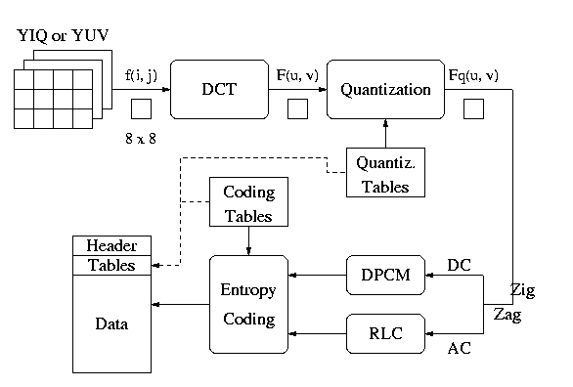
JPEG image compression-Block diagram

Slide 47
Image Compression-JPEG
I. Block Preparation:
Performed before DCT.
Dividing the source image into blocks of size 8 pixels * 8 pixels.
CLUT (Color look up Table) is used for continuous tone grayscale image. 8 bit value for each pixel.
For color image 3 2D array of pixel values corresponding to R, G & B.
its values are shifted from a positive range to one centered on zero. For an 8-bit image, each entry in the original block falls in the range [0,255]. The midpoint of the range (in this case, the value 128) is subtracted from each entry to produce a data range that is centered on zero, so that the modified range is [-128,127]. This step reduces the dynamic range requirements in the DCT processing stage.

Slide 48
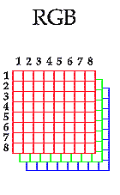
Block preparation breaks each 2D array of the image into individual blocks of 8X8 pixel per blocks.
48

Slide 49
For video frame
Divided into Y, C_{b} , C_{r} format.
Array for C_{b} , C_{r} is usually smaller than Y.
[Y is the luma component and C_{B} and C_{R} are the blue-difference and red-difference chroma components.]
Y = .3R+.6G+.1B
U = B-Y
V = R-Y
C_{b} = U/2 +.5
C_{r} =V/1.6 +.5
C_{b} and C_{r} components are downsampled by a factor of 2. We can do this because the human eye gets more detail from the luminance information, than the chrominance.

Slide 50
Image Compression-JPEG
II. Discrete Cosine Transform(DCT):
Converts each block from spatial to frequency domain.
First component is known as DC component (F(0,0)) and the remaining are known as AC component.
DC component contains lowest frequency in both direction.
Determines the fundamental color of the block.
8x8 occupies a very small spatial region.
Most AC coefficients will quite small to zero and DC coefficient
Values of neighboring blocks will be same or similar.
Till now it is lossless (little losses due to the use of fixed point arithmetic ) and IDCT can retrieve back the original

Slide 51
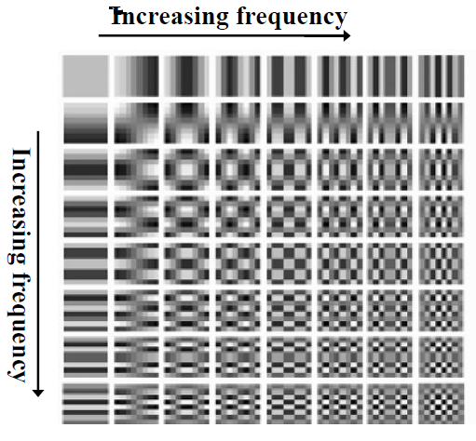
F_{u}
F_{v}
Source: JPEG Compression by Klara Nahrstedt

Slide 52
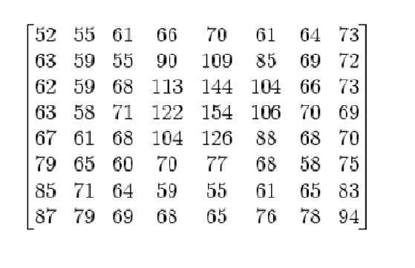
Example
Let a 8 X 8 block of pixels is

Slide 53
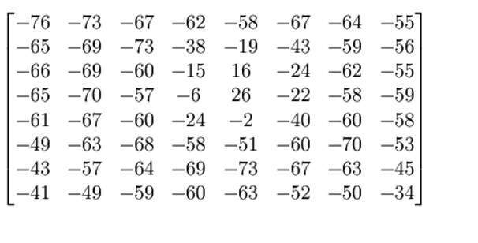
The range of the pixels intensities now are from 0 to 255. We will change the range from -128 to 127.

Slide 54
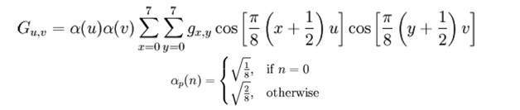
Now we will compute using this formula.
The result comes from this is stored in let’s say A(j,k) matrix.

Slide 55
Image Compression-JPEG
III. Quantization:
DCT itself does not achieve compression, but rather prepares the image for compression.
Human eyes responds primarily to DC co efficient and lower spatial frequency co efficient.
The higher frequency coefficients below a certain threshold will not be detected by the human eye.
Simply dividing each entry in frequency space block by an integer then rounding of.
.

Slide 56
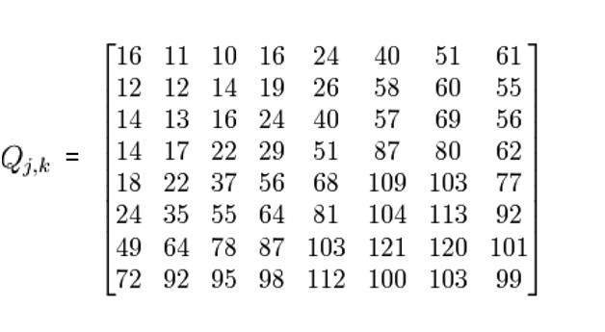
Example (Cont..)
There is a standard matrix that is used for computing JPEG compression, which is given by a matrix called as Luminance matrix.

Slide 57
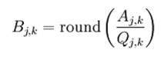
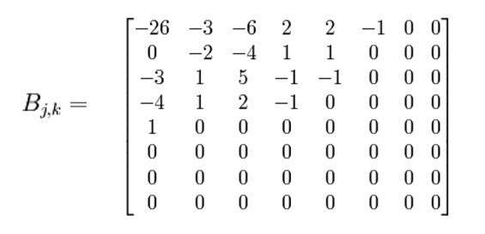
Applying the formula

Slide 58
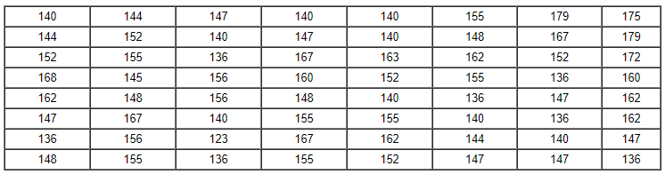
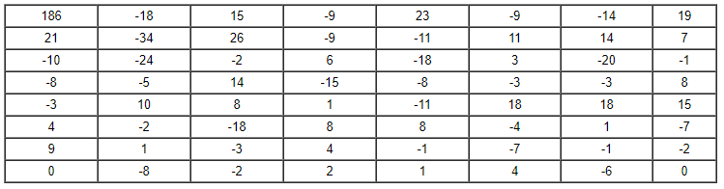
Another example
I
2D DCT

Slide 59
Q(u,v) is the quantization matrix entry.
In standard compression Q(u,v) has predefined values for luminance and chrominance.
Value of are smaller than F(u,v) and can be coded with fewer bits. [Value of Q(u,v) are relatively large]
The entries of Q(u,v) tend to have larger values towards the lower right corner. Producing more loss in higher frequencies.
Compression ratio can be changed by scaling the number in Q(u,v). A quality factor comes in the scenario

Slide 60
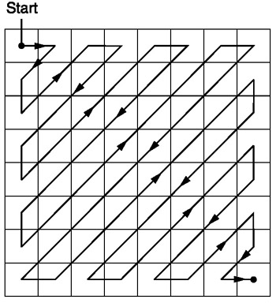
Image Compression-JPEG
IV. Preparation for entropy encoding:
Applied on quantized DCT co-efficient.
RLE, DPCM, Huffman coding are used.
All are lossless.
DC and AC co-efficient are treated differently in this step.

Slide 61
RLE: Applied on AC coefficient.
contains many ‘0’s .
Thus RLE can be effective.
To get a long run of ‘0’s a zig-zag scan is applied.
have a good chance of concatenating long runs of zeros.
RLE produces a pair (RUNLENGTH, VALUE) for each run of zeros in the AC co-efficients of
RUNLENGTH is the number of ‘0’s in run VALUE is the next nonzero coefficient.
A special pair (0,0) indicates the end of block
As example (0,6)(0,-1)(0,-1)(1,-1)(3,-1)(2,1)(0,0).

Slide 62
Image Compression-JPEG
DPCM:
Applied on DC coefficient.
DC value reflects the average intensity of each block.
DPCM is applied on DC coefficient of all blocks of the whole image.
DPCM coded DC coefficient is represented by a pair of symbols (SIZE, AMPLITUDE)
Example:
Let first 5 DC co-efficient are 150 155 149 152 144, DPCM will produce
150, 5, -6, 3, -8
This is represented as (8, 10010110) (3,101), (4,0110), (2,11), (4,0111).

Slide 63
Image Compression-JPEG
Huffman Coding:
on DC Co-efficients:
Applied on SIZE .
Most frequently occurred SIZE is assigned smaller bit.----Achieves compression.
After encoding a custom Huffman table is stored in JPEG image header.
on AC Co-efficient:
AC coefficients after RLE produce (RUNLENGTH, VALUE).
VALUE is further represented by (SIZE, AMPLITUDE).
RUNLENGTH & SIZE are squeezed to single byte allocating 4 bit to each.

Slide 64
Symbol 1: (RUNLENGTH, SIZE )
Symbol 2: (AMPLITUDE)
Occasionally zero-run length may exceed 15, then a special extension (15,0) is used for symbol 1
Symbol 1 is Huffman coded.

Slide 65
THANK YOU

